Slide 1
MS 4252
Big Data Analytics
Group Project
Drive
Cheng Tsz Ying 55029856
Chen Lee Wei 54334758
Ng Cheuk Him 54969545
Or Kei Lam 55062761

Slide 2
Agenda
Background
Objective 1 - Finding the pattern behind the customer comments (Text Analysis)
Objective 2 - Identifying the sentiment of customer comments (Sentiment Analysis)
Objective 3 - Comparing the performance with a major competitor (Sentiment Analysis)
Objective 4 - Discovering and predicting the pattern of the route (Link Analysis)
Conclusion

Slide 3
Background

Slide 4

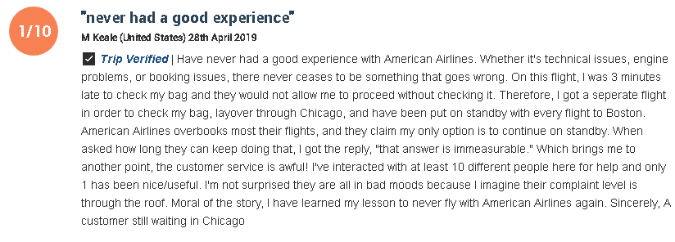

Company information:
US-Based airline company
One of the top 10 US airlines company
Extracting Data
From Skytrax - a consultancy which collect the airline services

Slide 5
Analysis Objectives
Aim to improve the service of American Airlines
Identify the potential issues discussed by customers for the American Airlines
Analysis the customer’s sentiments toward the company
Comparing American Airline with its competitors(United Airline) based on the topics
Identify new business opportunities for airlines

Slide 6
Objective 1 - Text Analysis
Finding the pattern behind the customer comments

Slide 7
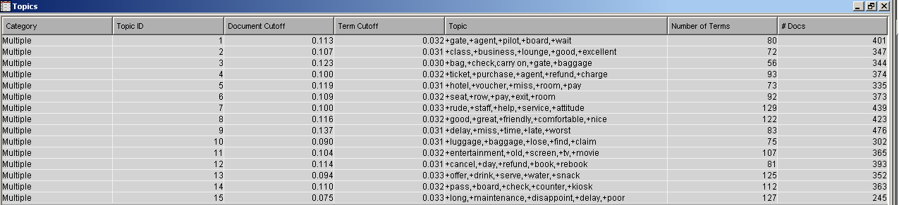
Objective 1 - Text Analysis
Finding the pattern behind the customer comments

Slide 8
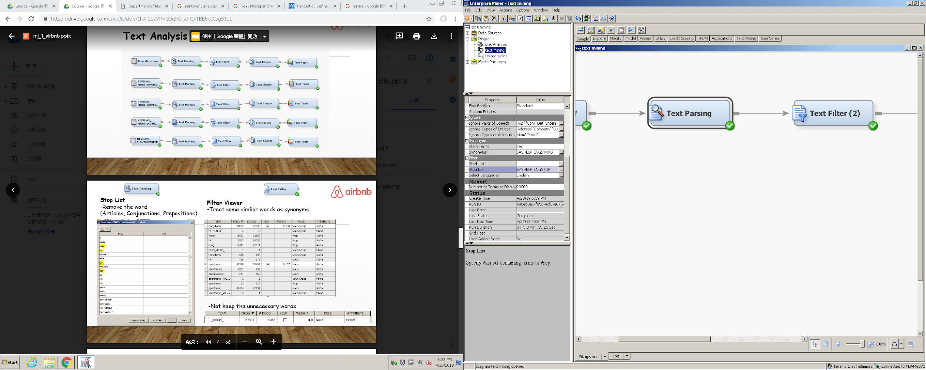

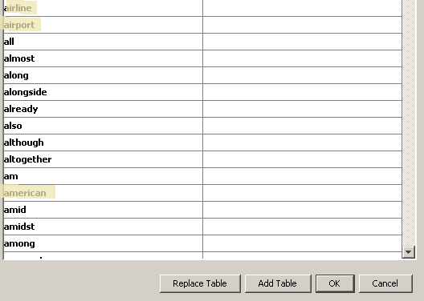
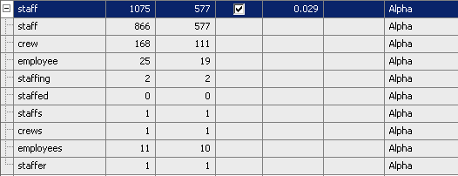
Objective 1 - Text Analysis
Finding the pattern behind the customer comments
-Remove the word (like airline, airport etc)
-Treat some similar words as synonyms
-Not keep the unnecessary words

Slide 9
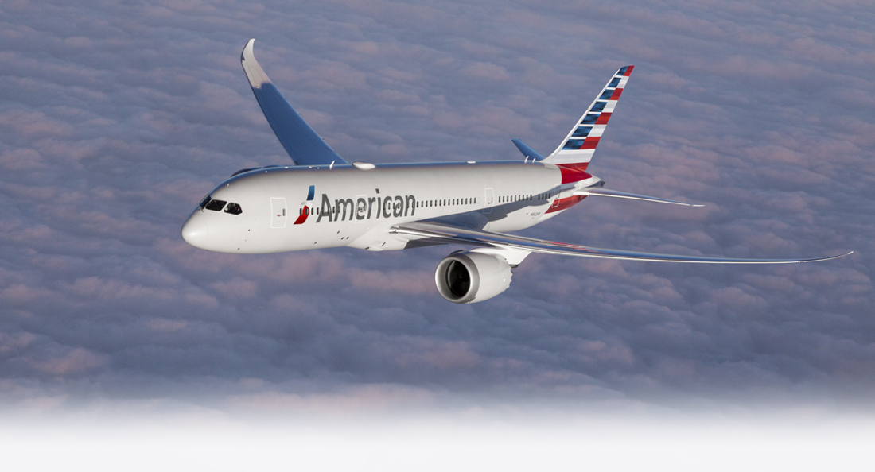
Summary -- (For Sentiment Analysis)
The Airline can find general information about the following topics
Inflight Entertainment
Staff attitude
Food & Beverage
Seat comfort
Finding the pattern behind the customer comments
Notes:
https://www.sightwordsgame.com/parts-of-speech/adjectives/positive/ (positive feeling)

Slide 10
Objective 1 - Text Analysis
Finding the pattern behind the customer comments
No. | Topic Terms | Issue
1 | +gate, +agent,+pilot, +board, +wait | Boarding
2 | +class, +business, +lounge, +good, +excellent | Lounge
3 | +bag, +check,+carry on, +gate, +baggage | Baggage
4 | +ticket,+purchase,+agent,+refund,+charge | Refund
5 | +hotel,+voucher,+miss,+room,+pay | Compensation
6 | +seat,+row,+pay,+exit,+room | Seat
7 | +rude,+staff,+help,+service,+attitude | Staff attitude
No. | Topic Terms | Issue
8 | +good, +great, +friendly, +comfortable, +nice | Overall comment
9 | +delay, +miss, +time, +late, +worst | Delay
10 | +luggage, +baggage, +lost, +find, +claim | Lost luggage
11 | +entertainment, +old, +screen, +tv, +movie | Entertainment
12 | +cancel, +day, +refund, +book, +re-book | Cancel booking
13 | +offer, +drink, +serve, +water, +snack | Food and Beverage
14 | +pass, +board, +check, +counter, +kiosk | Counter
15 | +long, +maintenance, +disappoint, +delay, +poor | Delay
Notes:
Lounge
Luggage & Baggage
Seat comfort
Staff attitude
Flight Attendant`
Entertainment
F&B

Slide 11
Objective 2 - Sentiment Analysis
Identifying the sentiment of customer comments

Slide 12
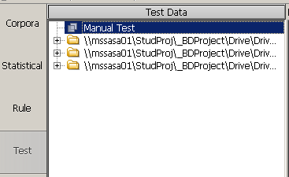
Objective 2 - Sentiment Analysis
Identifying the sentiment of customer comments
Training Dataset:
100 Positive comments
100 Negative comments
Validation Dataset:
100 Positive comments
100 Negative comments
Overall Comments: 2830

Slide 13
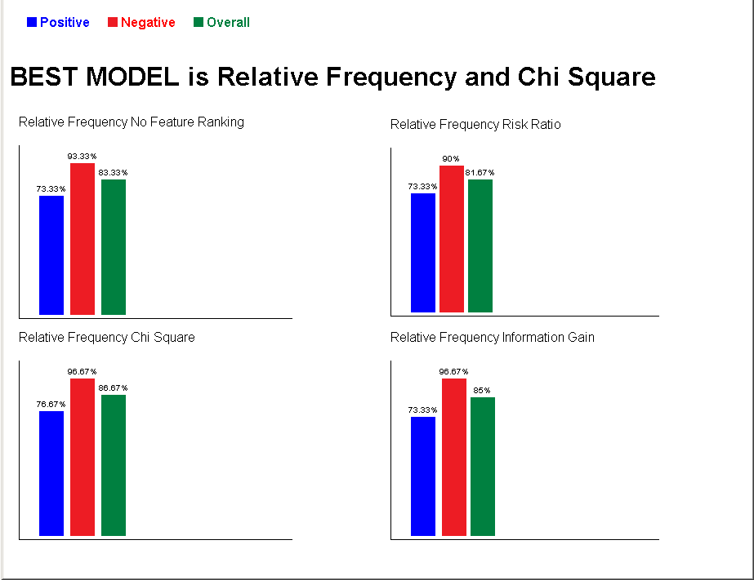
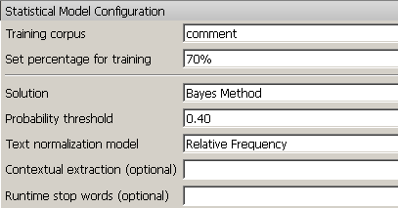
Objective 2 - Sentiment Analysis
Identifying the sentiment of customer comments
Building Advanced Statistical Models:

Slide 14
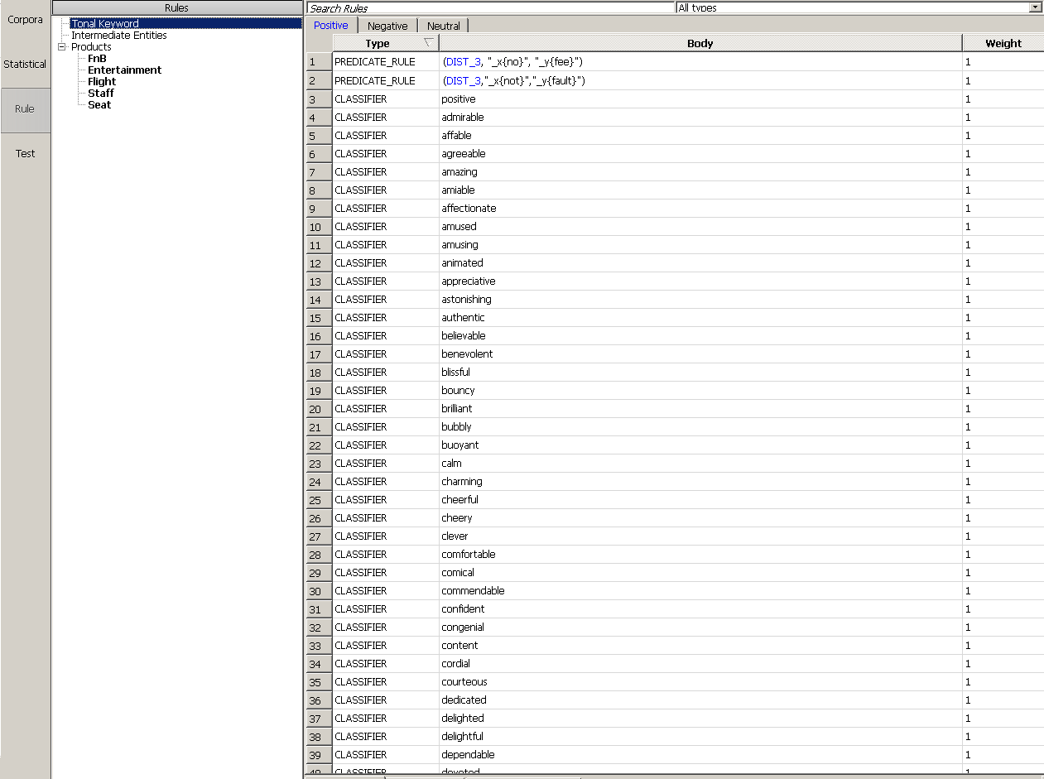
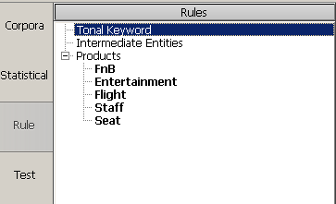
Objective 2 - Sentiment Analysis
Identifying the sentiment of customer comments
Building Rule Base Models:
Positive adjective:
https://www.sightwordsgame.com/parts-of-speech/adjectives/positive/
Negative adjective:
http://positivewordsresearch.com/negative-feelings-and-emotions/
Notes:
http://positivewordsresearch.com/negative-feelings-and-emotions/ (negative feeling)

Slide 15
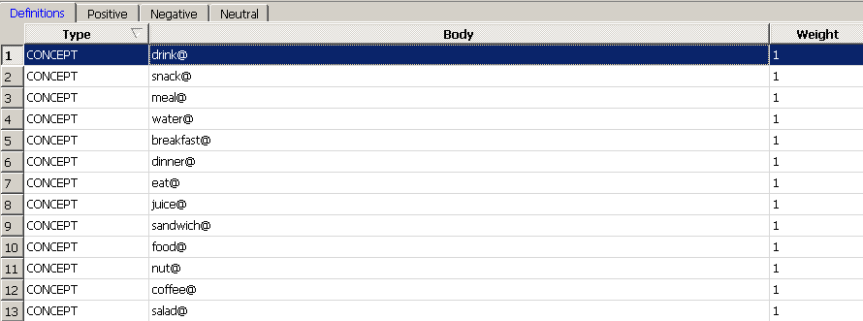
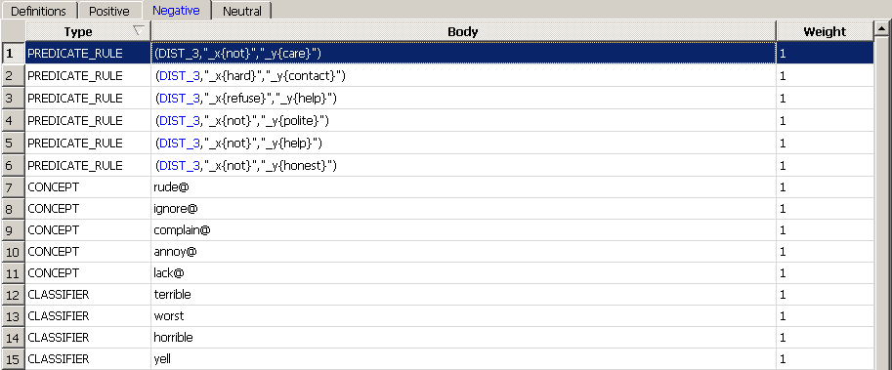
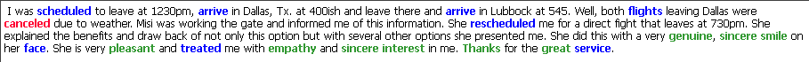
Objective 2 - Sentiment Analysis
Identifying the sentiment of customer comments
Building Rule Base Models:
Definition of Food and Beverages:
Negative Rule of Staff:
Result:
Notes:
http://positivewordsresearch.com/negative-feelings-and-emotions/ (negative feeling)

Slide 16
Objective 2 - Sentiment Analysis
Identifying the sentiment of customer comments
Validation:
Model | Advanced Statistic | Rule-based | Hybrid
Positive Testing (Out of 100) | Positive: 79 Negative: 21 Neutral: 0 | Positive: 91 Negative: 4 Neutral: 5 | Positive: 91 Negative: 9 Neutral: 0
Negative Testing (Out of 100) | Positive: 8 Negative: 91 Neutral: 1 | Positive: 6 Negative: 90 Neutral: 4 | Positive: 6 Negative: 93 Neutral: 1
Overall Precision | 85% | 90.5% | 92%

Slide 17
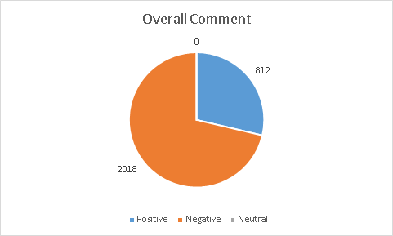
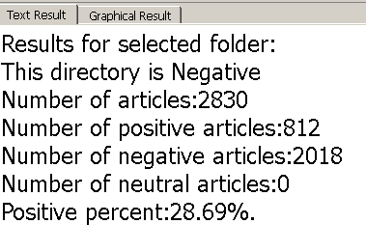
Objective 2 - Sentiment Analysis
Identifying the sentiment of customer comments
Overall:
The overall performance is poor

Slide 18
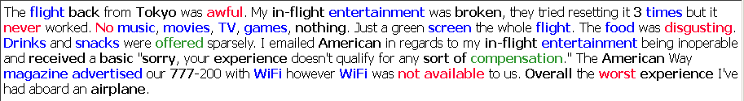
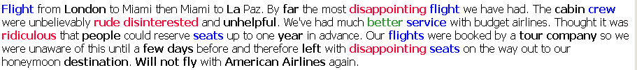
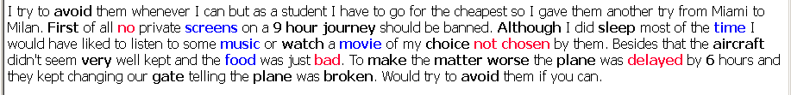
Objective 2 - Sentiment Analysis
Identifying the sentiment of customer comments

Slide 19
Objective 3 - Text & Sentiment Analysis
Comparing the performance with a major competitor

Slide 20
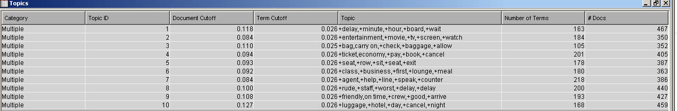
Objective 3 - Text Analysis
Extract the topics from comments for competitor(United Airline)

Slide 21
Objective 3 - Text Analysis
Topics in competitors’ comments
No. | Topic Terms | Issue
1 | +delay,+minute,+hour,+board,+wait | Delay
2 | +entertainment,+movie,+tv,+screen,+watch | Entertainment
3 | +bag,+carry on, +check, +baggage,+allow | Baggage
4 | +ticket,economy,+pay,+book,+cancel | Ticket
5 | +seat,+row,+sit,+seat,+exit | Seat
6 | +class,+business,+first,+lounge,+meal | Lounge
7 | +agent,+help,+line,+speak,+counter | Hotline
8 | +rude,+staff,+worst,+delay,+delay | Staff attitude
9 | +friendly,on time,+crew,+good,+arrive | Staff attitude
10 | +luggage,+hotel,+day,+cancel,+night | Flight cancellation
Notes:
Lounge
Luggage & Baggage
Seat comfort
Staff attitude
Flight Attendant`
Entertainment
F&B

Slide 22
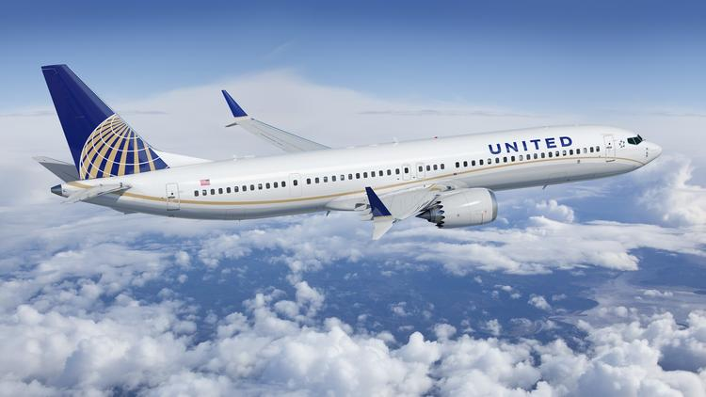
Summary -- (For Sentiment Analysis)
Comparison on the following topics
Inflight Entertainment
Staff attitude
Seat comfort
Comparing the performance with a major competitor
Notes:
https://www.sightwordsgame.com/parts-of-speech/adjectives/positive/ (positive feeling)

Slide 23
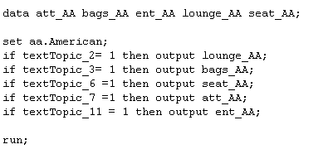
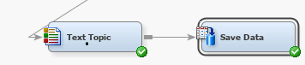
Objective 3 - Text Analysis
Extract the comments based on Topics
Download the comments from EM with the binary variables for topics for both United and American airlines
Filter the datasets to each topics

Slide 24
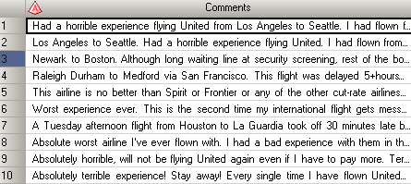
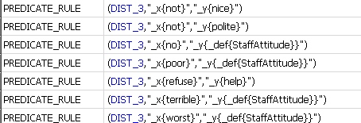
Objective 3 - Sentiment Analysis for topics
Based on the rule-based model built previously
100 training samples in each topics
=> identify the features which influence the sentiment of comments based on topics
20 positive and 20 negative validation data

Slide 25
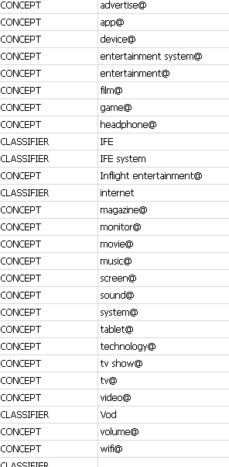
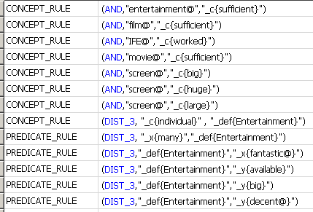
Objective 3 - Sentiment Analysis for topics
Topic1- Entertainment
Identify 27 items related to entertainment
47 positive and 54 negative terms
Results:

Slide 26
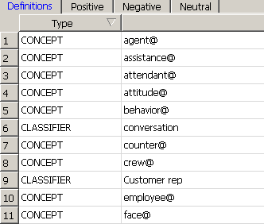
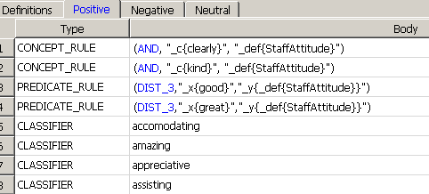
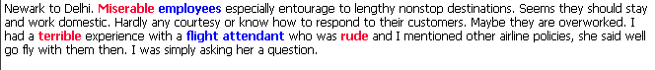
Objective 3 - Sentiment Analysis for topics
Topic 2- Staff
Identify 27 items related to staff attitude
42 positive and 44 negative terms
Result:

Slide 27
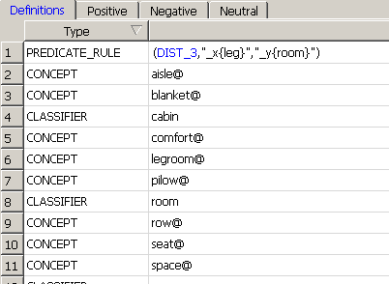
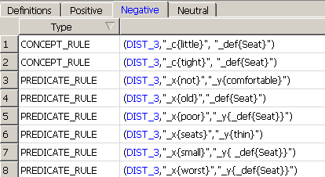
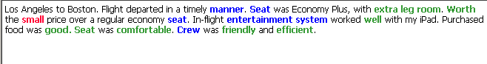
Objective 3 - Sentiment Analysis for topics
Topic 3 - Seat
Identify 11 items related to Seat
11 positive and 24 negative terms
Result:

Slide 28
Validation- Entertainment
 | Predict Positive | Predict Neutral | Predict Negative
True Positive (out of 20) | 16 | 0 | 4
True Negative (out of 20) | 1 | 2 | 17
Overall Precision: 82.5%
Positive Precision: 80%
Negative Precision: 85%

Slide 29
Validation- Staff
 | Predict Positive | Predict Neutral | Predict Negative
True Positive (out of 20) | 20 | 0 | 0
True Negative (out of 20) (1 unclassified) | 2 | 2 | 15
Overall Precision: 87.5%
Positive Precision: 100%
Negative Precision: 75%

Slide 30
Validation- Seat
 | Predict Positive | Predict Neutral | Predict Negative
True Positive (out of 20) | 16 | 3 | 1
True Negative (out of 20) | 0 | 2 | 18
Overall Precision: 85%
Positive Precision: 80%
Negative Precision: 90%

Slide 31
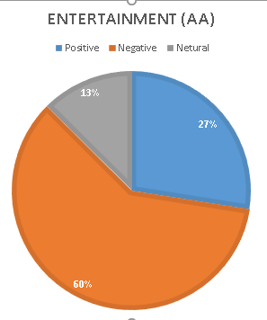
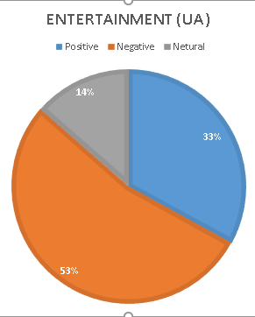
Result - Entertainment
American Airline
Positive | 77
Negative | 168
Netural | 35
Unclassified | 60
United Airline
Positive | 95
Negative | 154
Netural | 39
Unclassified | 44

Slide 32
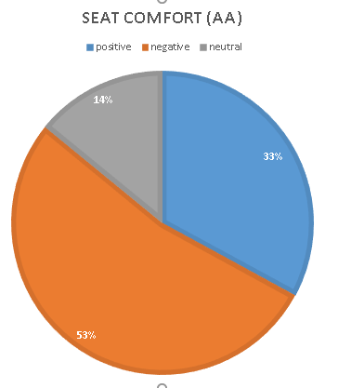
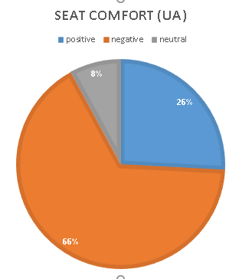
Result - Seat
American Airline
Positive | 77
Negative | 124
Netural | 33
Unclassified | 137
United Airline
Positive | 62
Negative | 159
Netural | 19
Unclassified | 140

Slide 33
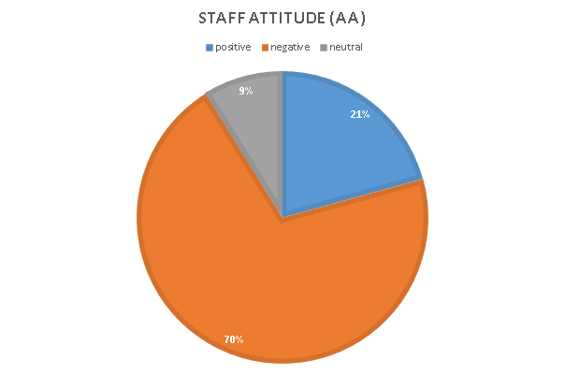
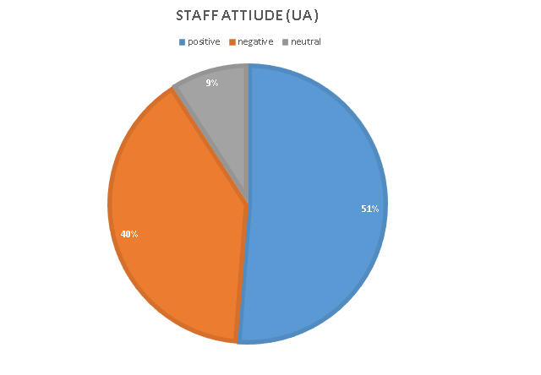
Result - Staff Attitude
American Airline
Positive | 87
Negative | 296
Netural | 37
Unclassified | 18
United Airline
Positive | 373
Negative | 289
Netural | 66
Unclassified | 76

Slide 34
Objective 3
Comparing the performance with a major competitor
Except the staff attitude for United Airlines, both airlines had more than 50% negative comments
For the attitude of airlines’ staff, United airline has more than half positive comments.
=> Where American Airlines has 70% of negative comments
American airlines had more positive comments in seat comfort
United airlines had less negative comments in entertainment in proportion

Slide 35
Objective 4 - Link Analysis
Discovering and predicting the pattern of the route
Notes:
https://www.fool.com/investing/2019/04/10/american-airlines-begins-expanding-biggest-hubs.aspx
http://news.aa.com/news/news-details/2018/Summertime-and-the-Travel-Is-Easy-American-Airlines-Introduces-18-New-Routes-and-Adds-Seats-to-Paris-And-Madrid/default.aspx

Slide 36
Objective 4 - Link Analysis
Discovering and predicting the pattern of the route
95 domestic destinations and 95 international destinations
Plan to reduce the routes to reduce cost
Cancelled Chicago to Shanghai from October 2018
Plan to increase the routes at Dallas and Charlotte
Largest and Most Profitable Hubs
Begin “Dallas to San Luis Obispo” from April 2019
Ability to fly to small cities
Notes:
Last week, American Airlines (NASDAQ:AAL) began new routes from its hub at Dallas-Fort Worth International Airport (DFW) to four small cities: Monterey, Burbank, and San Luis Obispo, California; and Flagstaff, Arizona. These new routes are particularly significant because they mark one of the first steps in a major expansion by American Airlines at its two largest hubs: DFW and Charlotte.
Indeed, American Airlines plans to operate 905 peak-day departures at DFW by July -- up from 809 a year earlier -- as it gains access to 15 additional gates. A smaller increase in departures is coming in Charlotte later this year. Management expects growth at the carrier's two largest and most profitable hubs to drive a much-needed turnaround at American Airlines.
Big hubs generate high margins
Large network carriers like American Airlines have higher costs than discount airlines. Their main competitive advantage is the ability to fly to small cities (where competition is limited and fares are high) and offer connecting service to destinations around the world. By clustering as many flights as possible in a single "bank" at a hub, network carriers can maximize the number of potential connecting itineraries, driving high unit revenue.

Slide 37
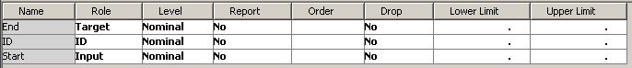
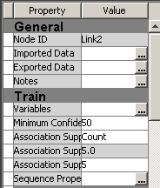
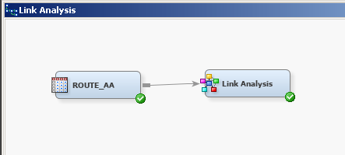
Objective 4 - Link Analysis
Discovering and predicting the pattern of the route
Notes:
Rejected the Sequence since the route is undirected.
Min Confidence 50%
Association Support Count: 5
Support： 就是一個元組在整個資料庫中出現的機率。P（condition）
minimum support：界定一個規則必須涵蓋的最少資料數目
Confidence：界定一個規則預測強度(信心水準)。P（condition and result）/ P（ condition）
minimum confidence可信度：界定一個規則最小預測強度(信心水準)。
190P2 = 35910
Support (A ⇒B) = P(A ∩B)：A與B共同出現的機率，數值越大越好
Confidence (A ⇒B) = P(B | A)：在A出現的前提下，出現B的的機率，數值越大越好

Slide 38
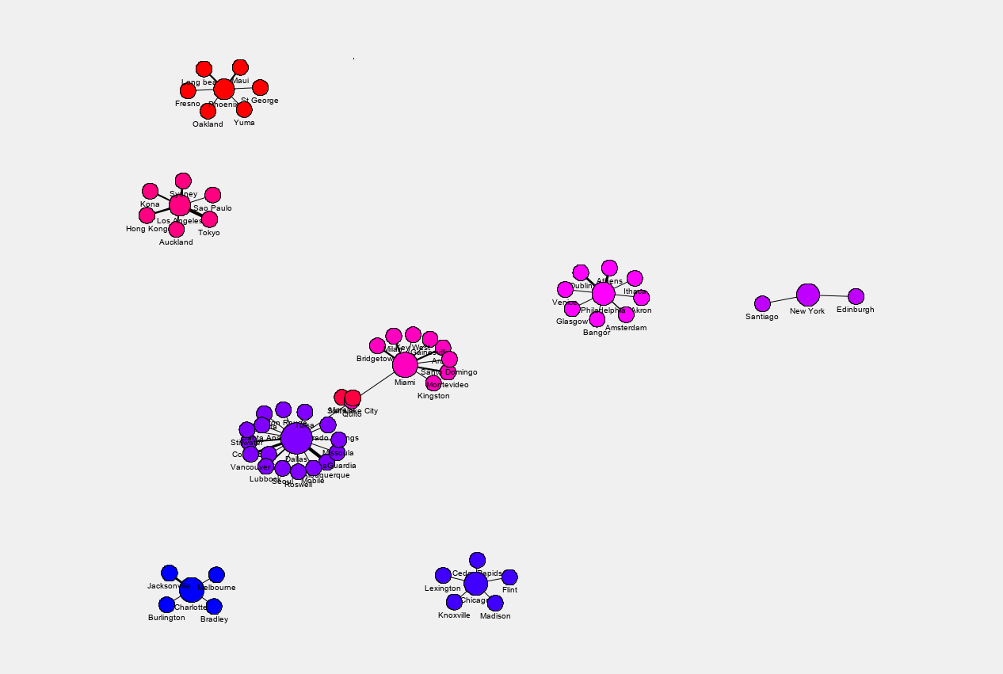
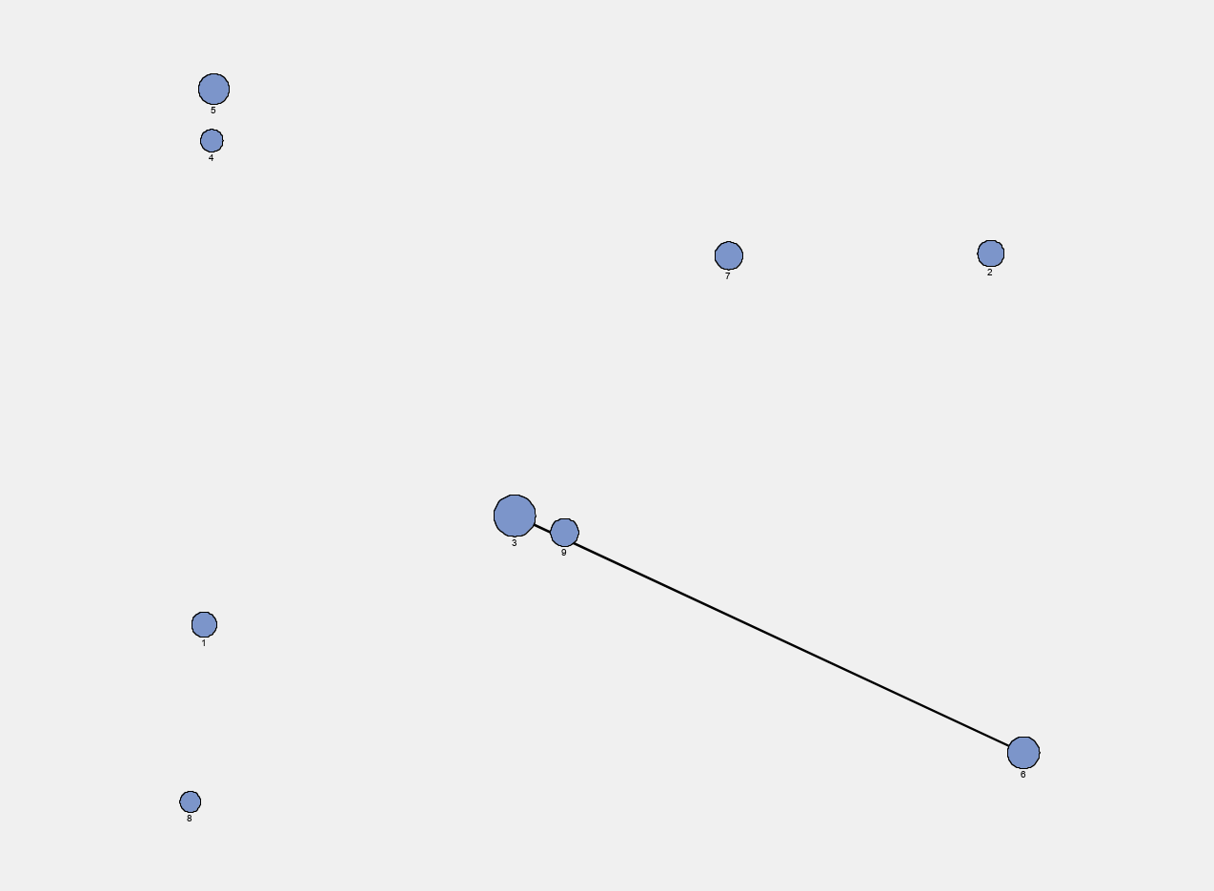
Objective 4 - Link Analysis
Discovering and predicting the pattern of the route
Number of Nodes: 66
Number of Links: 58
Iterm-Cluster: 9

Slide 39
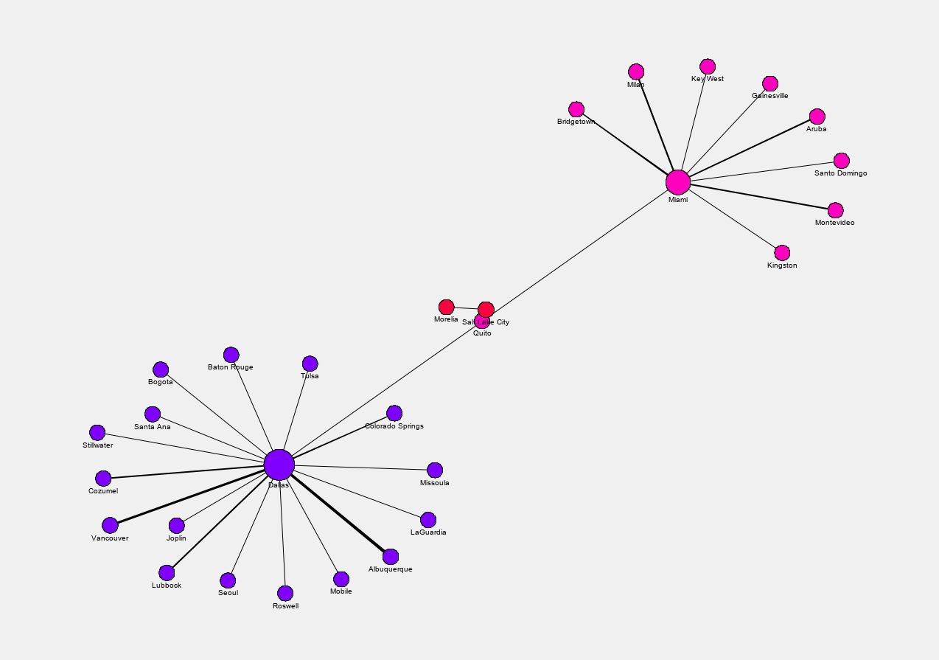
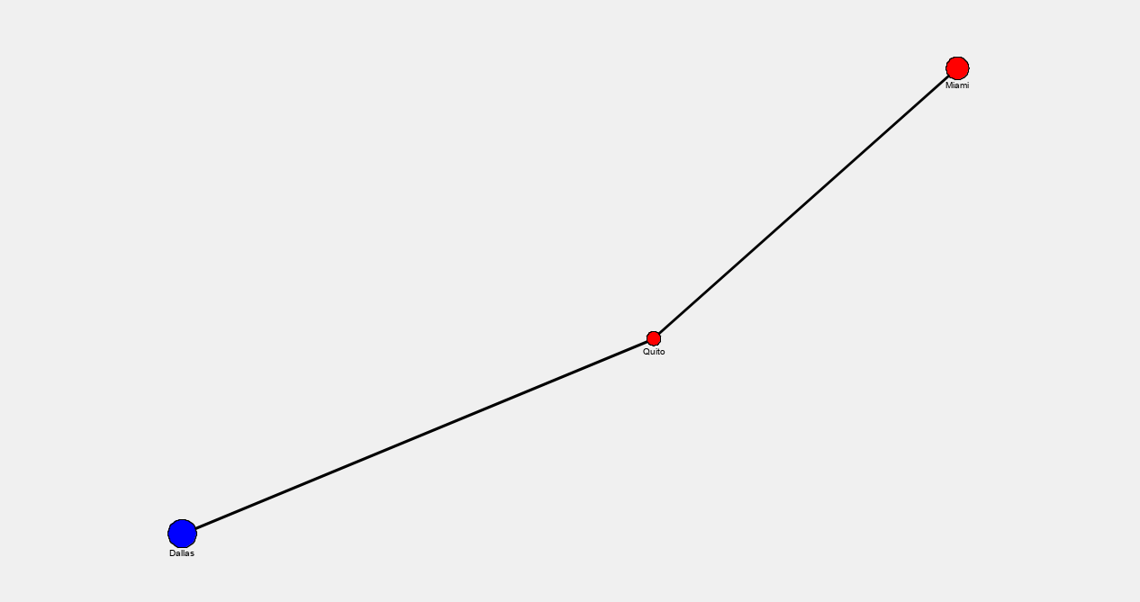
Objective 4 - Link Analysis
Discovering and predicting the pattern of the route
Cluster 3 and Cluster 6
A bridge: Quito and Miami

Slide 40
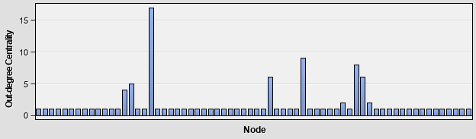
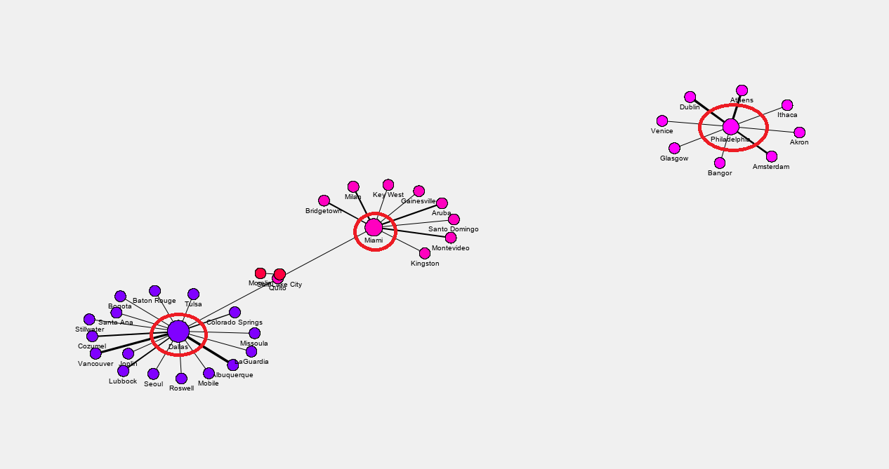
Objective 4 - Link Analysis
Discovering and predicting the pattern of the route
Out-degree Centrality
Dallas:17
Miami: 9
Philadelphia: 8
Notes:
Higher the degree -> The node is more centra

Slide 41
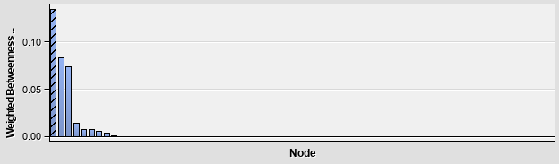
Objective 4 - Link Analysis
Discovering and predicting the pattern of the route
Betweenness Centrality
Dallas = 0.134615
Miami = 0.082692
Quito = 0.073558
Notes:
The higher the betweenness centrality indicates that the nodes is more important

Slide 42
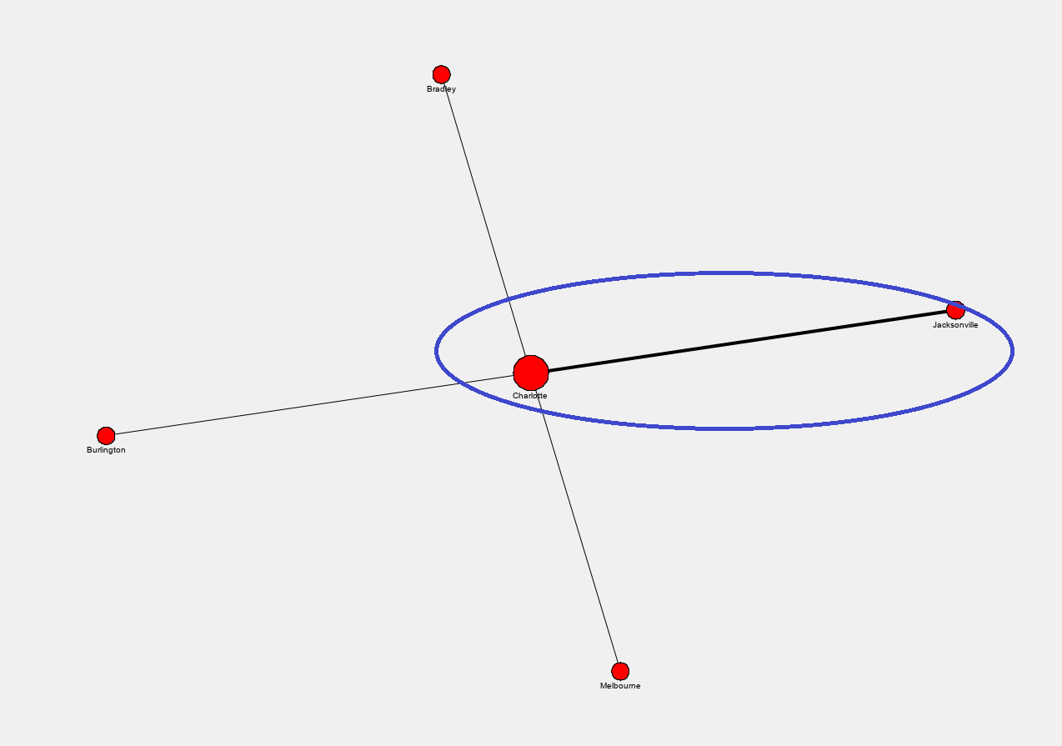

Objective 4 - Link Analysis
Discovering and predicting the pattern of the route
Charlotte to Jacksonville
Miami to Milan

Slide 43


Objective 4 - Link Analysis
Discovering and predicting the pattern of the route
Dallas to Albuquerque
Philadelphia to Athens

Slide 44

Objective 4 - Link Analysis
Discovering and predicting the pattern of the route
Add Dallas to Santo Domingo
Cluster 3 and 6
Add Dallas to Gainesville
Cluster 3 and 6
Add Miami to Knoxville
Don’t cancel
Dallas to Quito
Miami to Quito
Notes:
Based on the precious infor, american would like to expand the Dallas
https://www.fool.com/investing/2019/04/10/american-airlines-begins-expanding-biggest-hubs.aspx
https://www.anna.aero/2019/01/07/american-airlines-launches-26-new-routes-in-three-weeks/

Slide 45
Conclusion

Slide 46

Conclusion
The comments for the American airlines were mostly related to the staff attitude, seat comfort, entertainment, and the meals inflight
Overall, more than 75% of customers in the dataset did not enjoy their flight experience
Comparing to the competitor, American Airlines need to improve its staff attitude and seat comfort
The company should retain or add new routes for Dallas and Miami

Slide 47
Thank You
Q&A

